Slide 1
Postsecondary Education in Appalachia
Presentation to the
Appalachia Funders Network
June 14, 2023
Andrew Koricich, Ph.D.
Adam Ray
regionalcolleges.org | @ARRC_Research

Slide 2
About ARRC
Established in 2020 with seed funding from the Joyce Foundation, the Alliance for Research on Regional Colleges (ARRC, “arc”) is a research collaborative and resource hub with the mission of increasing appreciation for and understanding of regional colleges and their contributions to educational opportunity and community wellbeing. Since July 2021, ARRC has been officially housed at Appalachian State University.
2

Slide 3
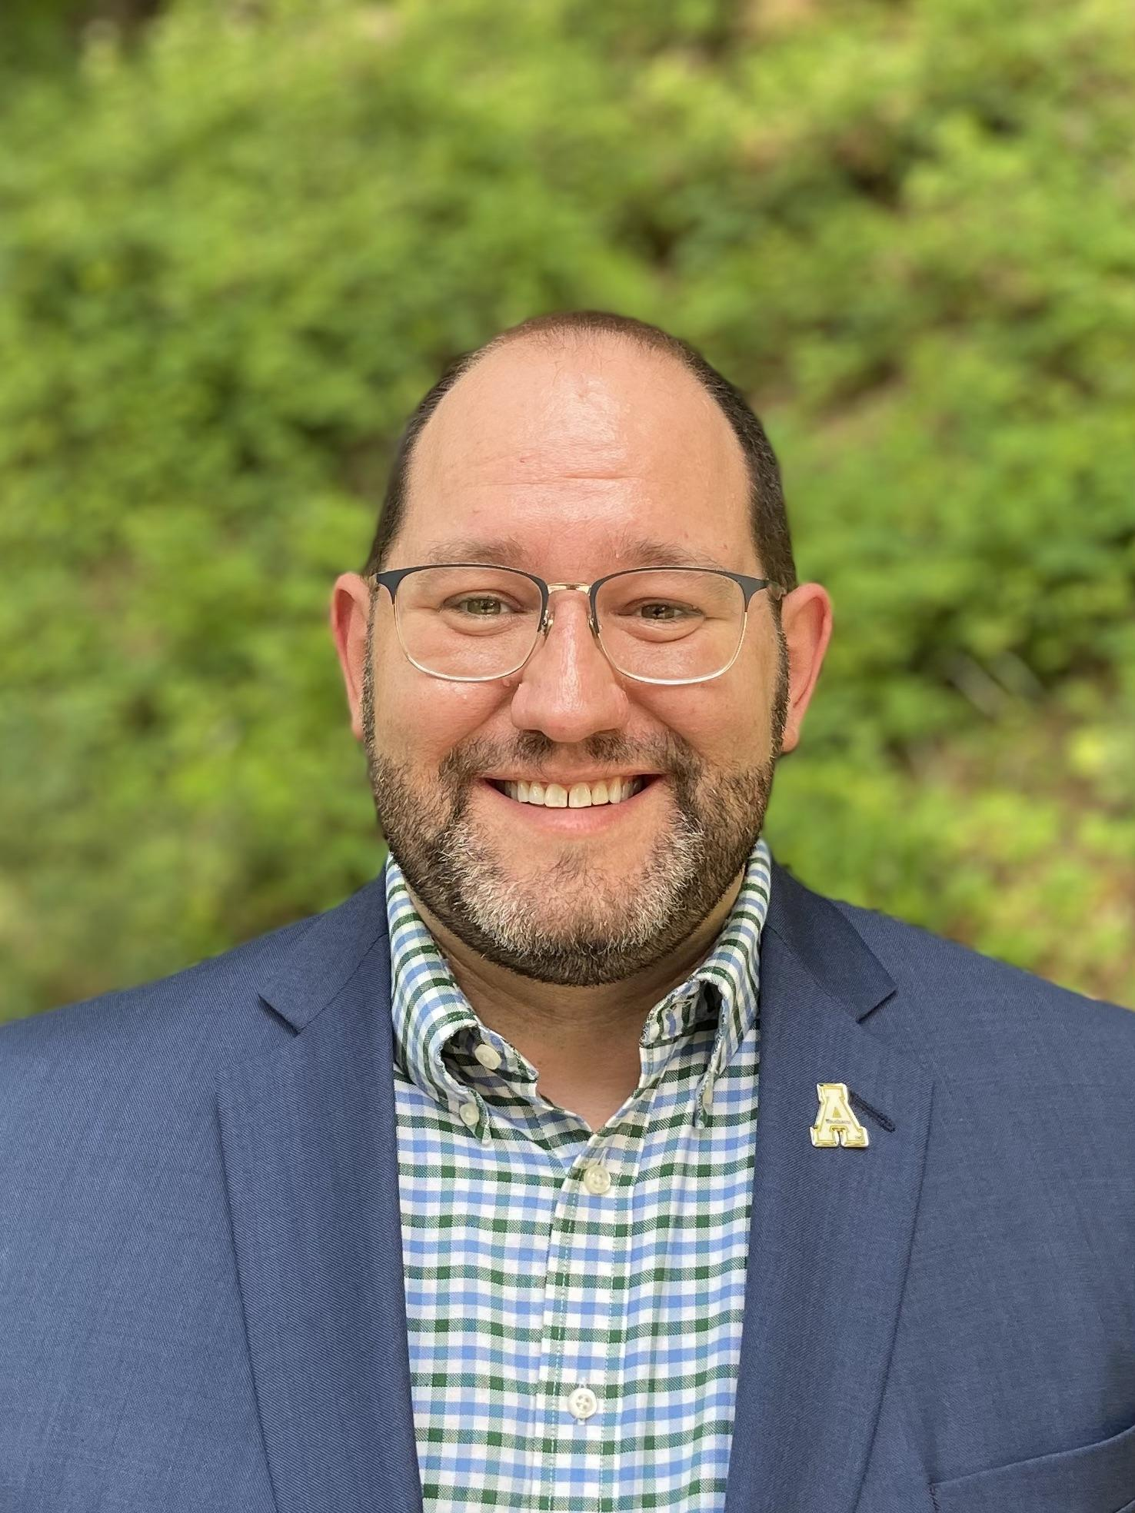
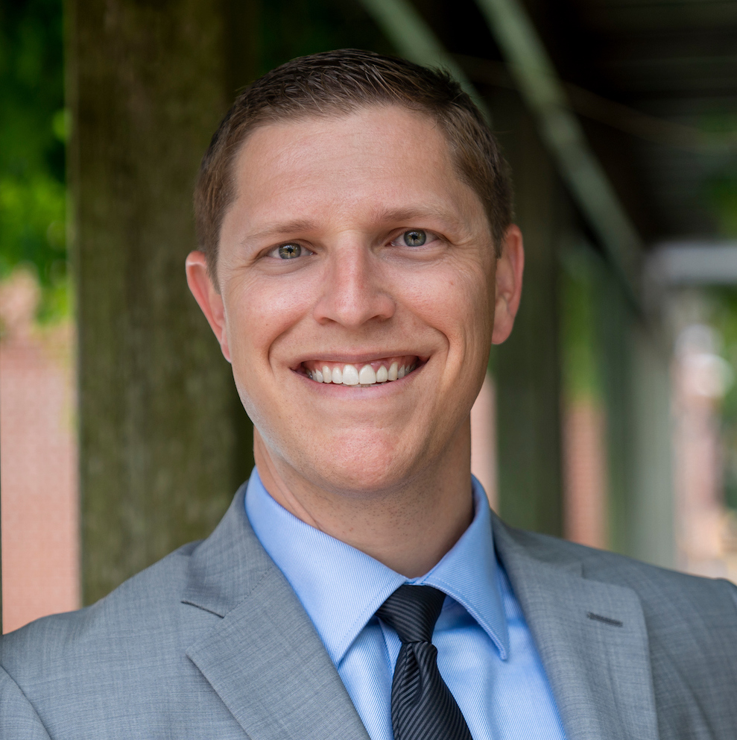
Board of Directors
Dr. Andrew Koricich
Executive Director
Appalachian State University
Dr. Alisa Fryar
Director of Data
University of Oklahoma
Dr. Kevin McClure
Director of Public Engagement
University of North
Carolina Wilmington
Dr. Cecilia Orphan
Director of Partnerships
University of Denver
Dr. Vanessa Sansone
Director of Policy
University of Texas at
San Antonio
3

Slide 4
Student Experiences in Appalachia
Bachelor’s degree-holding rates in Appalachia are only about 77% that of the national average.
More students at broad-access institutions (BAIs) in rural Appalachia attend full-time than outside of Appalachia
A larger percentage of students at Appalachian BAIs receive Pell grants
Overall, 6-year graduation rates are higher at rural BAIs in Appalachia than outside, including among Pell recipients
4

Slide 5
Student Experiences in Appalachia
Compared to rural and urban non-BAIs in the region, rural BAIs still enroll larger shares of Pell grant recipients.
However, graduation rates for Pell recipients is much lower than at rural and urban non-BAIs in Appalachia.
One factor that encourages success among this student population is a sense of belonging on campus and in academic spaces.
5

Slide 6
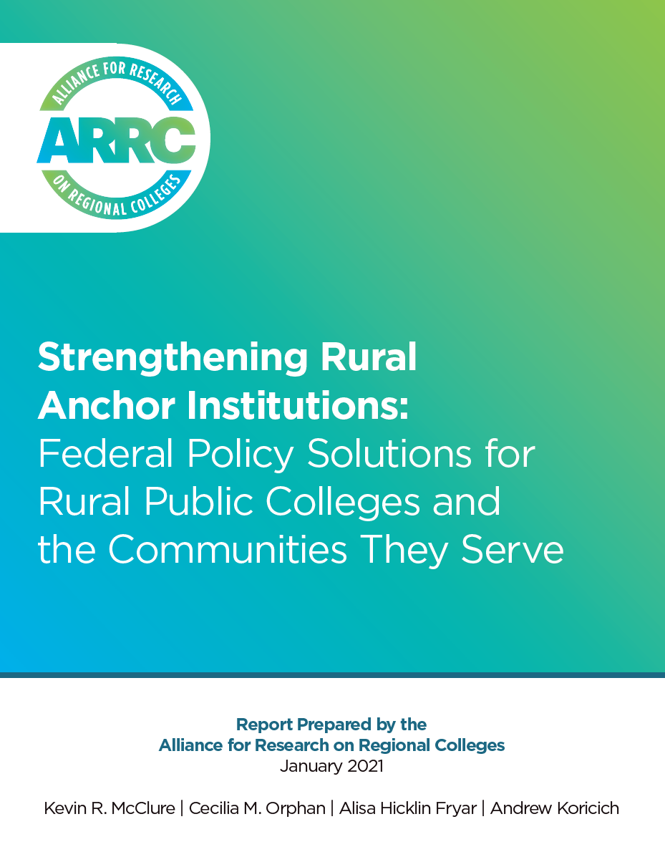
Colleges as Anchor Institutions
What are “anchor institutions?”
Place-bound entities and vital to the wellbeing of their regions.
Hospitals, schools, colleges, social services, etc.
6

Slide 7
Colleges as Anchor Institutions
Rural colleges provide an essential access point for educational opportunity in their regions.
Sustaining local economies and fueling community vitality
Culture/arts programming, community-support services, small business incubation, etc.
Providing educated workers for high-demand industries, including local healthcare and school systems.
7

Slide 8
Colleges as Anchor Institutions
Partners in building public health infrastructure, especially during the COVID-19 pandemic.
ARRC’s RSI Map Tool for exploring colleges in the region
8

Slide 9
Considerations for Philanthropy
College is expensive, and scholarships are helpful. But scholarships are expensive to fund in perpetuity.
Need for emergency aid
Food and housing insecurity
Transportation and child care assistance
Funding development of high-demand academic programs
9

Slide 10
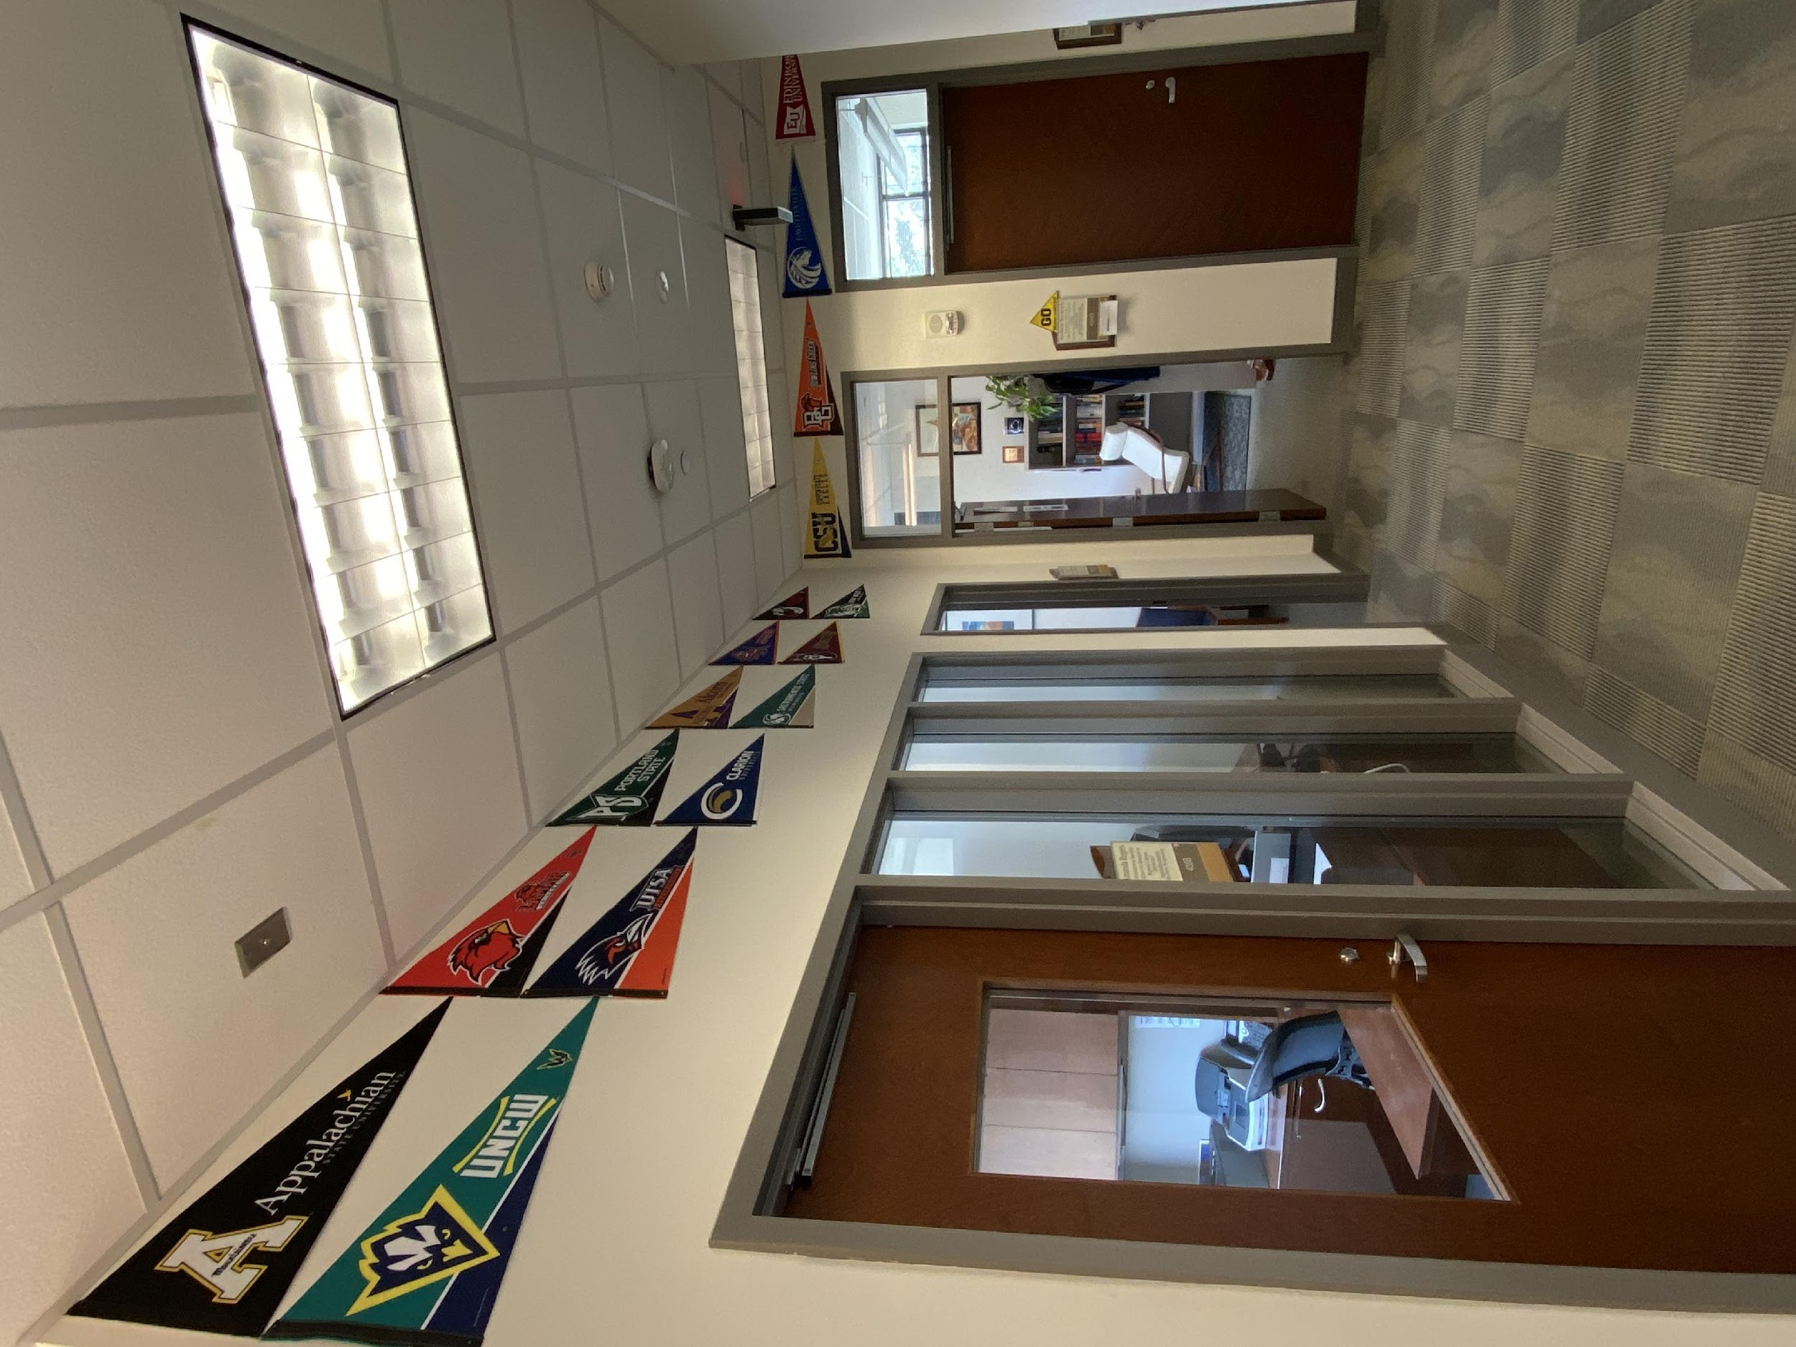
Shameless Plug…
Stay in touch!
Dr. Andrew Koricich
koricichma@appstate.edu
C. Adam Ray
rayca@appstate.edu
regionalcolleges.org | info@regionalcolleges.org | @ARRC_Research
Does your institution have branded pennants? If so, we’d love to display yours in our office suite, which is a place where all regional colleges are valued and have a home.
10

